Slide 1
Blood Relations

Slide 2
Symbol Representation
+
Male
A
-
Female
B
Married Couple
A B
Siblings
C D
Children
A B
C D

Slide 3
Relations with respect to you:
Parent -
Father / Mother
Sibling -
Brother / Sister
Uncle -
Father’s / Mother’s Brother
Parent’s Brother
Aunt -
Father’s / Mother’s Sister
Parent’s Sister
Nephew -
Brother’s / Sister’s Son
Sibling’s Son
Niece -
Brother’s / Sister’s Daughter
Sibling’s Daughter
Cousin -
[Father’s/Mother’s] [Brother’s / Sister’s] [Son/Daughter]
[Parent’s] [Sibling’s] [Child]
Paternal - Father’s side relations
Maternal – Mother’s side relations
Father’s brother –Paternal Uncle
Mother’s brother - Maternal Uncle
Un-married Male - Bachelor
Un-married Female - Spinster

Slide 4
Father in Law-
Husband’s / Wife’s Father
Spouse Father
Mother in Law-
Husband’s / Wife’s Mother
Spouse Mother
Brother in Law-
Husband’s / Wife’s Brother
Spouse Brother
Sister’s Husband
Sister in Law-
Husband’s / Wife’s Sister
Brother’s Wife
Son in Law-
Daughter’s Husband
Daughter in Law-
Son’s Wife

Slide 5
How is
A related to B
B related to A
A and B to each other
C related to D
D related to C
C and D related to each other
G related to H/I
H/I related to G
A related to G
B related to G
G related to A/B
A related to H/I
H related to A/B
D related to G
G related to D
C related to H/I
H related to C
I related to C
+
-
A B
+
-
+
-
E
C D
F
-
+
-
G
H
I

Slide 6


Slide 7
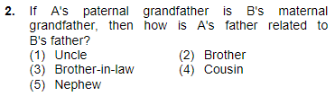

Slide 8


Slide 9
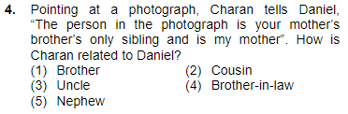

Slide 10


Slide 11
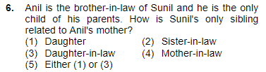

Slide 12


Slide 13
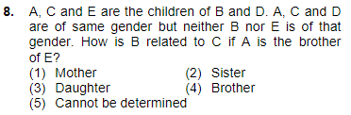

Slide 14
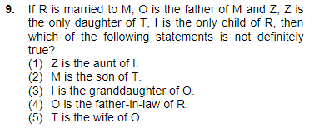

Slide 15
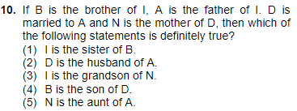

Slide 16

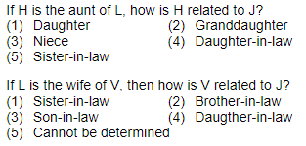

Slide 17
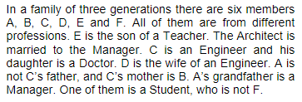

Slide 18
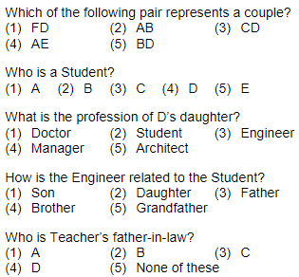

Slide 19
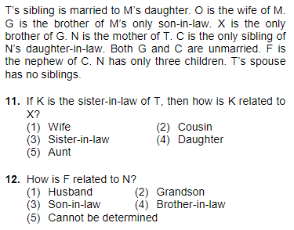

Slide 20



Slide 21
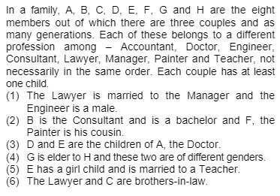

Slide 22
